Slide 1
Nash’s Systolic Implementation Of Faddeev’s Algorithm in VHDL.
Tejas Tapsale.

Slide 2
Introduction
A systolic array is composed of matrix-like rows of data processing units called cells. Data processing units (DPUs) are similar to central processing units (CPU)s. Each cell shares the information with its neighbors immediately after processing. The systolic array is often rectangular where data flows across the array between neighbor DPUs, often with different data flowing in different directions. The data streams entering and leaving the ports of the array are generated by auto-sequencing memory units, ASMs. Each ASM includes a data counter. In embedded systems a data stream may also be input from and/or output to an external source.
An example of a systolic algorithm might be designed for matrix multiplication. One matrix is fed in a row at a time from the top of the array and is passed down the array, the other matrix is fed in a column at a time from the left hand side of the array and passes from left to right. Dummy values are then passed in until each processor has seen one whole row and one whole column. At this point, the result of the multiplication is stored in the array and can now be output a row or a column at a time, flowing down or across the array.^{[2]}
Advantages and Disadvantages
Pros :-Faster, Scalable.
Cons :-Expensive, Highly specialized for particular applications, Difficult to build.

Slide 3
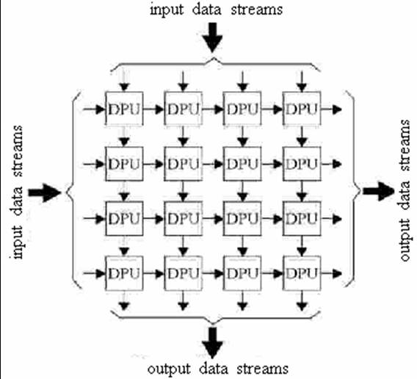
Systolic Array

Slide 4
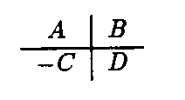
Faddeev’s Algorithm
The matrix version of the faddeev algorithm evaluates the expression CX+D subject to the condition AX=B, where A, B, C, D are given matrices, X is a column vector, and A is of full rank. The algorithm can be expressed by representing the data as the extended matrix.
Several matrix operation are possible by selecting specification entries for matrices A, B, C and D. Following figure shown such alternatives, which include matrix multiplication/addition, matrix inversion and solution of linear system of equations.

Slide 5
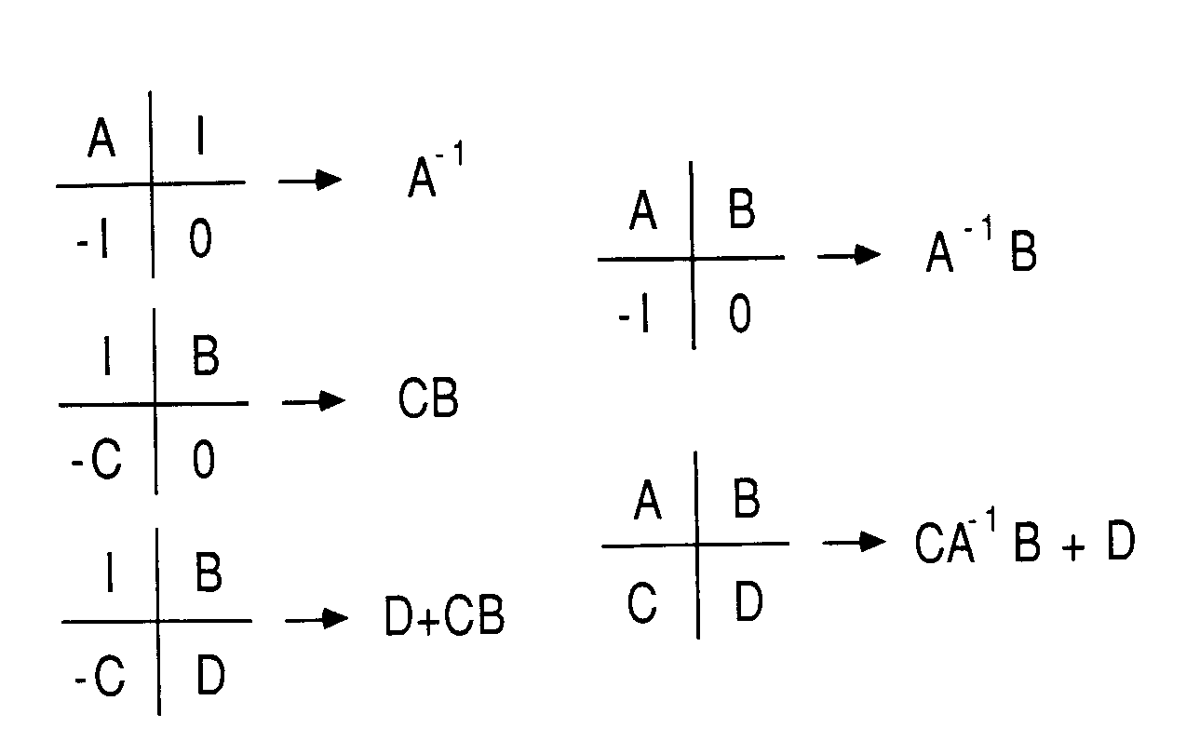
Example of matrix operation available with Faddeevs Algorithm

Slide 6
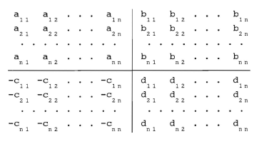
Problem Formulation

Slide 7
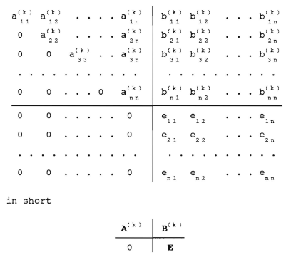
Result

Slide 8
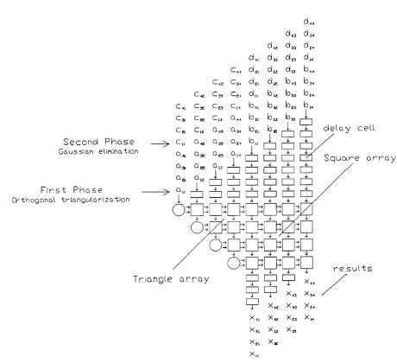
Nash’s Implementation

Slide 9
Working
This algorithm can be divide in to two-phase:
First Phase:- Matrix A is triangularized by a series of given rotations (simultaneously applied to B)
Second Phase:- The diagonal elements of the resulting triangular matrix are used as pivoting elements in the Gaussian elimination procedure on C and D. Where columns of C will be zeroed out and D will become the result.
In Nash’s systolic implementation consists of two types of cells Circular cell and Square cell.

Slide 10
Circular cells
In circular cell initiate modification of incoming data row.
This cell generates modification factors, values resulting from computations performed on an incoming entry and the cell’s own stored value.
The modification factors (Cout, Sout) are then send rightward to meet other entries of the same data row in the square cells.
There, they are used to modify the entries which are subsequently outputted to the next array row.
These cells do Orthogonal triangularization on matrix A in first phase and ordinary Gaussian elimination on matrix C in second phase.

Slide 11
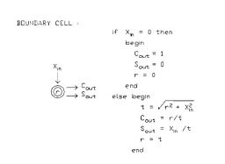
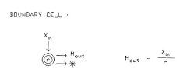
Microcode Specification of Circular Cell
First Phase
Second Phase

Slide 12
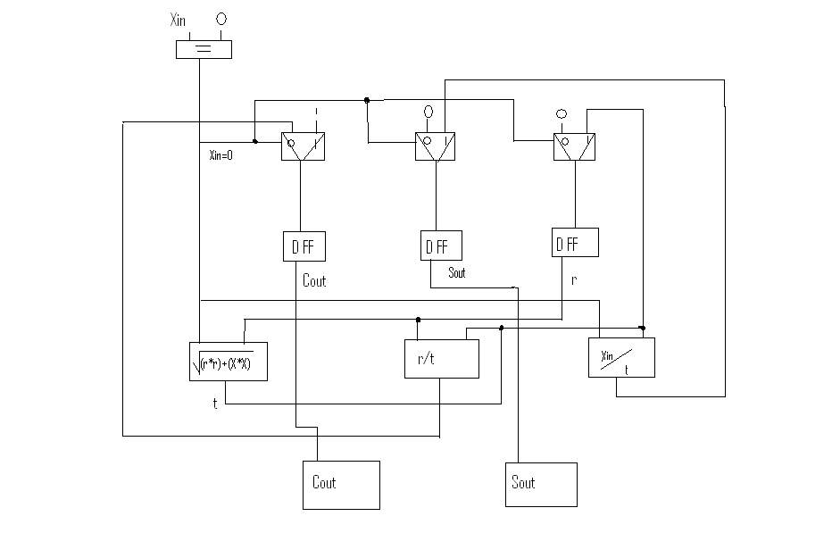
Design Architecture of Circular Cell

Slide 13
Square Cells
In square cell they use modified entries from circular cell (Cin, Sin) and subsequently outputted to next array row.
While cells of any given array row are updating a data row and they may also update their own currently stored value.
Here because of the critical timing required for the rightward data stream to reach internal cells at proper moments, the input data flow is fed into array in a skewed order.
After completion, modified X values left in cells constitute elements of a triangularized matrix and it is stored in matrix D.
In first phase It process the data and send Xout and stores new value of R where as in second phase it process the data and send new value of Xout and it dose not change value of Internal resistor R.

Slide 14
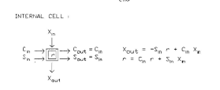
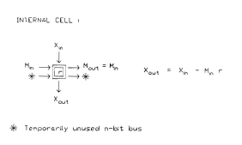
Microcode specification of Square Cell
First Phase
Second Phase

Slide 15
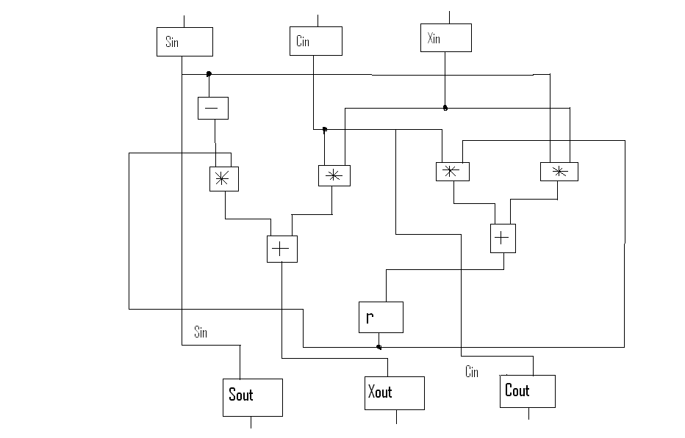
Design Architecture of Square Cell

Slide 16
Thank
You

